Slide 1

Introduction to Feature Selection
Soumya Banerjee

Slide 2

Supervised learning

Slide 3
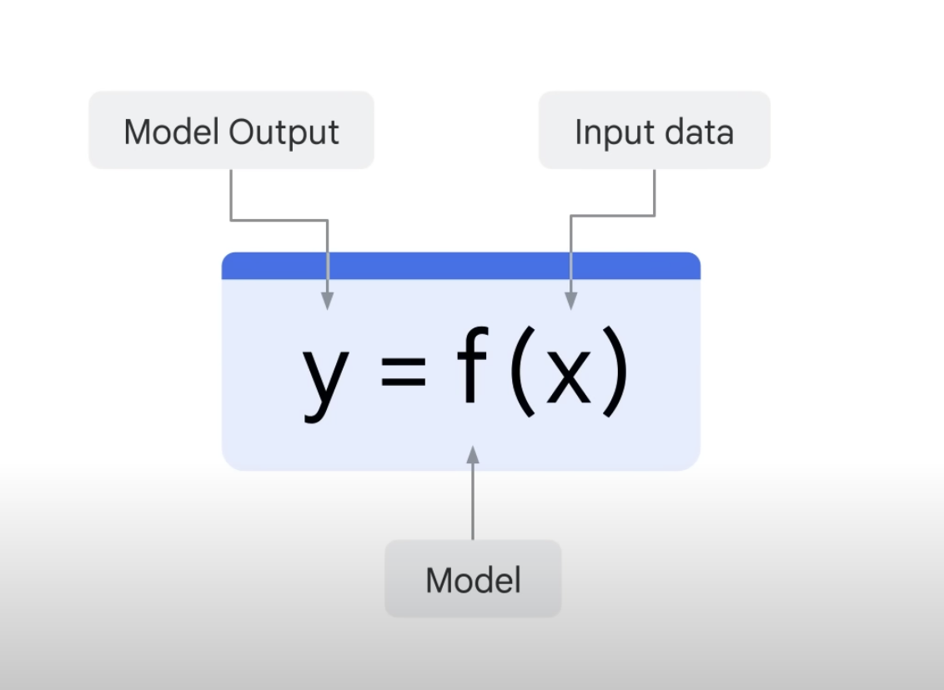
Supervised learning

Slide 4
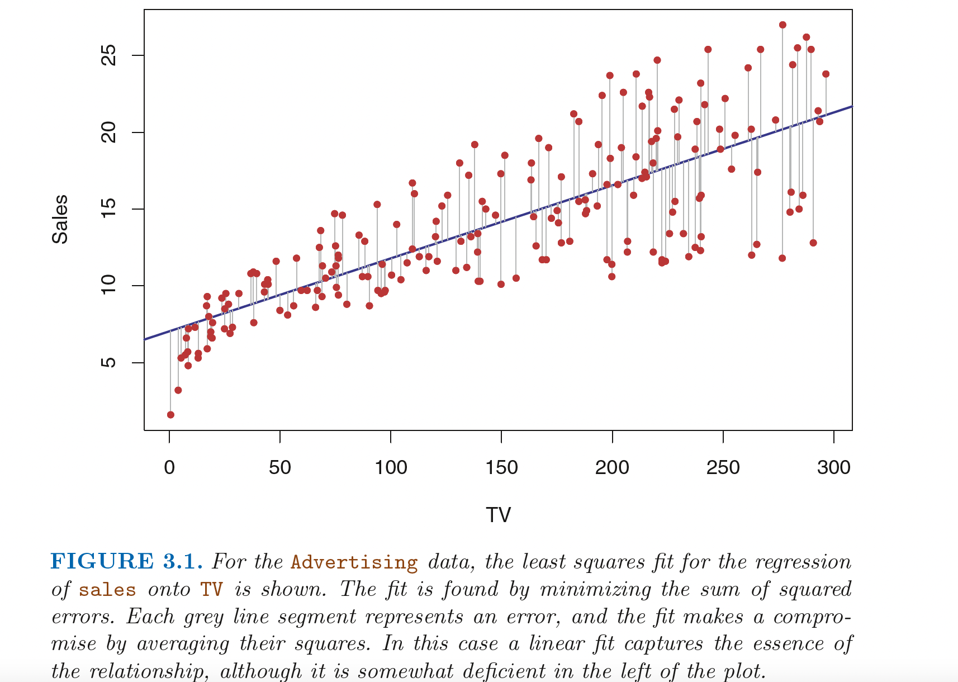

Linear regression
Notes:
I pick those which are consistent
From
~/periphery_project/bioinformatics/microarray_holm_il23/maplot_limma_pbmc_microarray_nick_RAWDATA_REANALYZED_samepatient_onedonorexcluded_usingpca_ALLPROBES_generic_ggrepel.pdf
generated from R ~/periphery_project/bioinformatics/microarray_holm_il23/holm_pbmc_microarray_limma_onedonorexcluded_usingpca_generic.rmd% (re-analyzed from raw data)% plots in right direction (flipped signs), with ggrepel and plots with max probes% plots publication ready plots

Slide 5
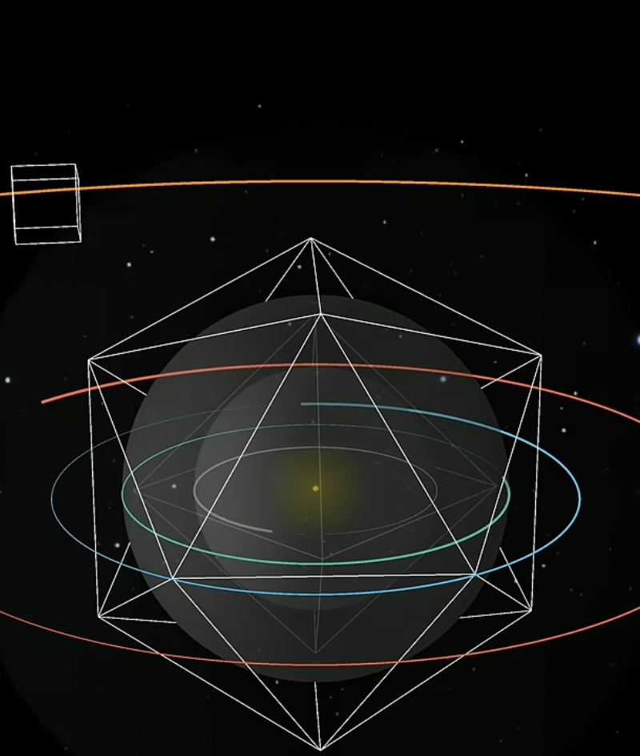
A fundamental concept in machine learning
Notes:
Kepler’s original theory 3blue1brown short

Slide 6
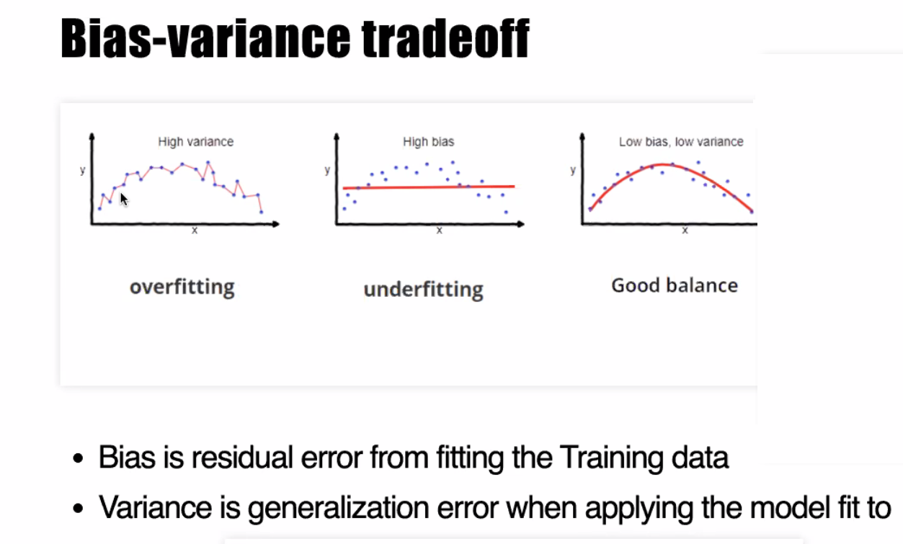
A fundamental concept in machine learning

Slide 7
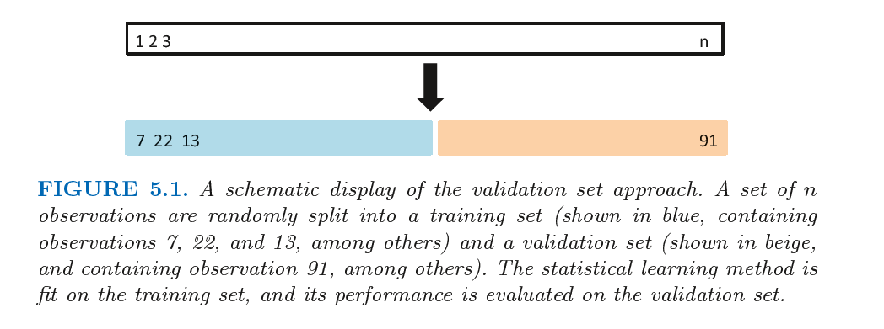
A fundamental concept in machine learning
An Introduction to Statistical Learning with Applications in R

Slide 8
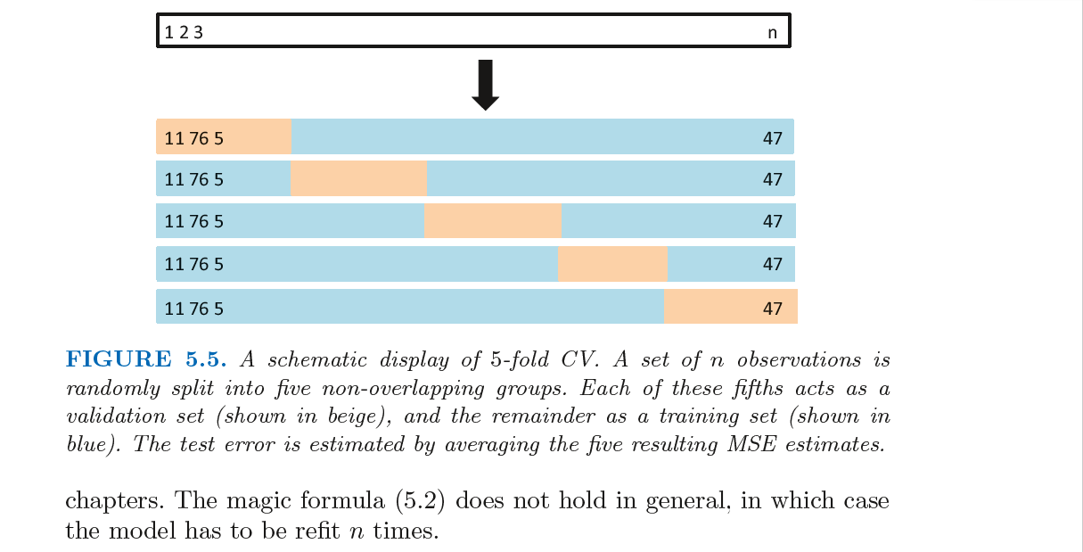
K-fold cross-validation
An Introduction to Statistical Learning with Applications in R

Slide 9
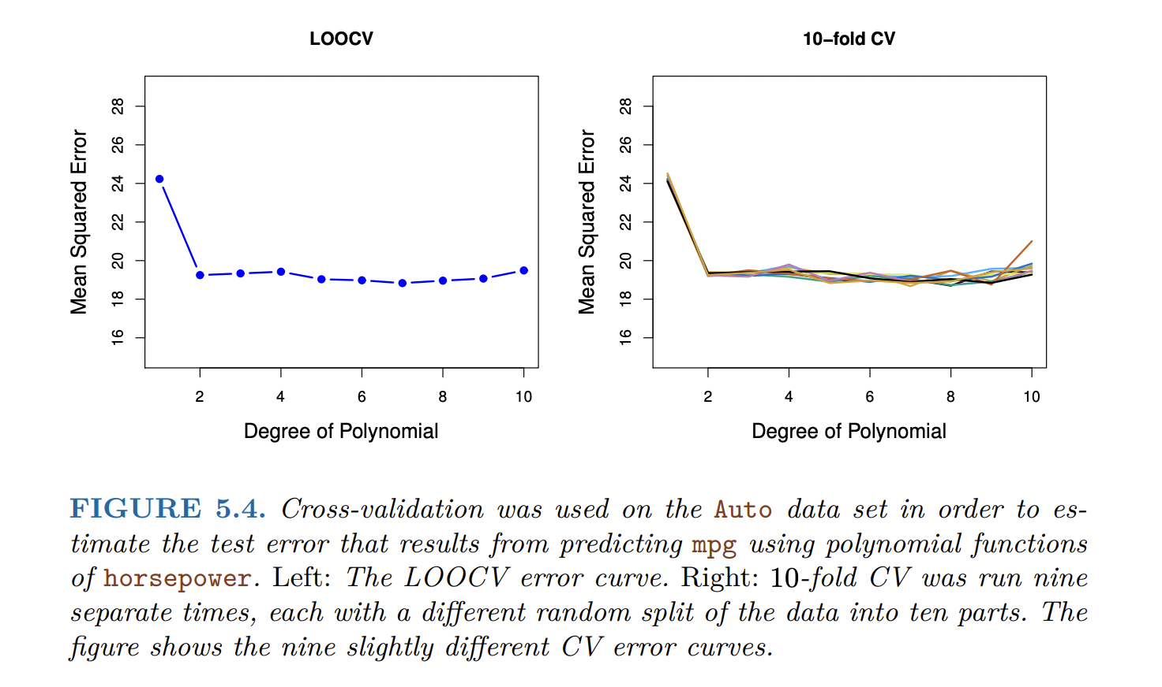
Cross-validation
An Introduction to Statistical Learning with Applications in R

Slide 10
What is a feature?
A feature is an individual measurable property or characteristic of a dataset.
Choosing the right features is crucial for building effective models
Examples: In marketing data, features might include age, income, or click rates.
In healthcare, features might be blood pressure or cholesterol level.
Features can be numerical (e.g. age) or categorical (e.g. gender, which must be encoded to numbers).

Slide 11
Why feature engineering?
Feature engineering transforms raw data into effective inputs. It can include creating new features, encoding or scaling existing ones, and handling missing values.
Well-engineered features enhance predictive accuracy and model interpretability
Choosing the right features is crucial for building effective models
Features built from domain knowledge (e.g. customer lifetime value in marketing, or BMI in health data) often capture important patterns that raw data alone may miss.

Slide 12

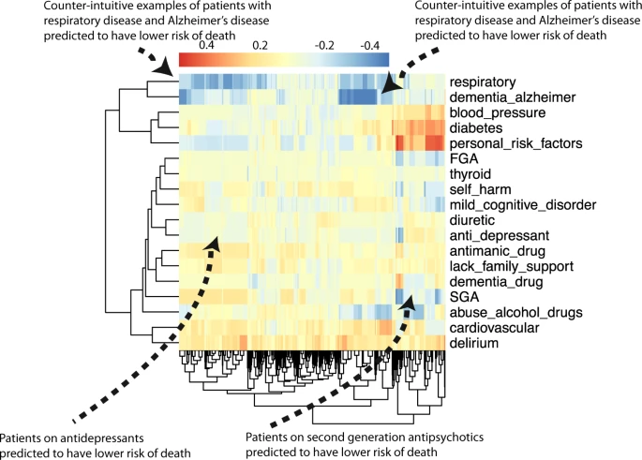

Example of feature engineering
NPJ Schizophrenia, 2021 (Nature Partner Journal), Impact factor 6.6

Slide 13
Feature selection
Feature engineering transforms raw data into effective inputs. It can include creating new features, encoding or scaling existing ones, and handling missing values.
Removing irrelevant or redundant features simplifies models.
Keeping only important features improves interpretability and reduces data collection costs in production
Advanced: The “curse of dimensionality” means too many features (especially noisy ones) can degrade performance. Pruning down to key predictors yields simpler models (link to cross-validation).

Slide 14
Feature selection - LASSO regression
LASSO stands for Least Absolute Shrinkage and Selection Operator. It is a linear regression that adds a penalty on coefficients
The penalty encourages some coefficients to become exactly zero, thus selecting a subset of features.
Intuitively, imagine fitting a regression but tying a rope (lasso) around the coefficients; weak features get “yanked” to zero and dropped from the model. This yields a sparse model that is easier to interpret. LASSO is powerful when you suspect only a few features truly matter.
By tuning the strength of the penalty (α), you control how many features are kept. It is especially useful when you have more features than samples or want an automated selection method.
Well-engineered features enhance predictive accuracy and model interpretability
How to select this penalty parameter (α)?

Slide 15
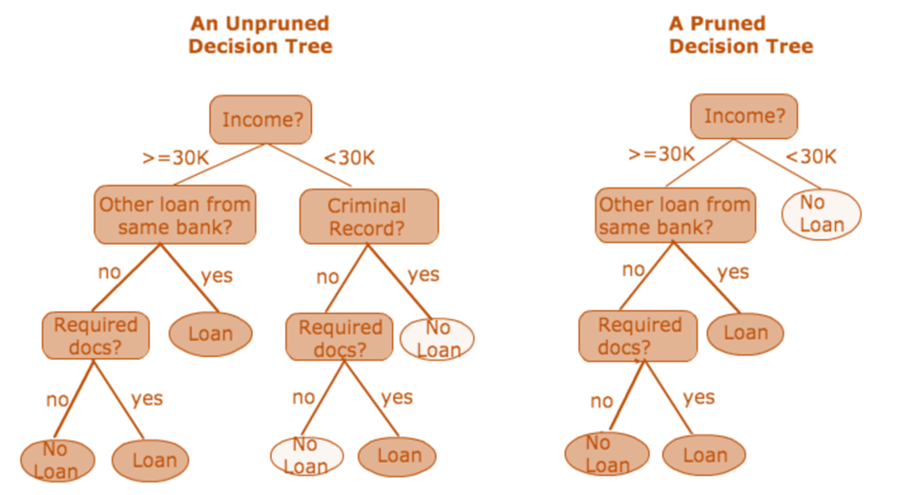
Decision Trees: how to get smaller trees
https://medium.com/@ompramod9921/decision-trees-8e2391f93fa7

Slide 16
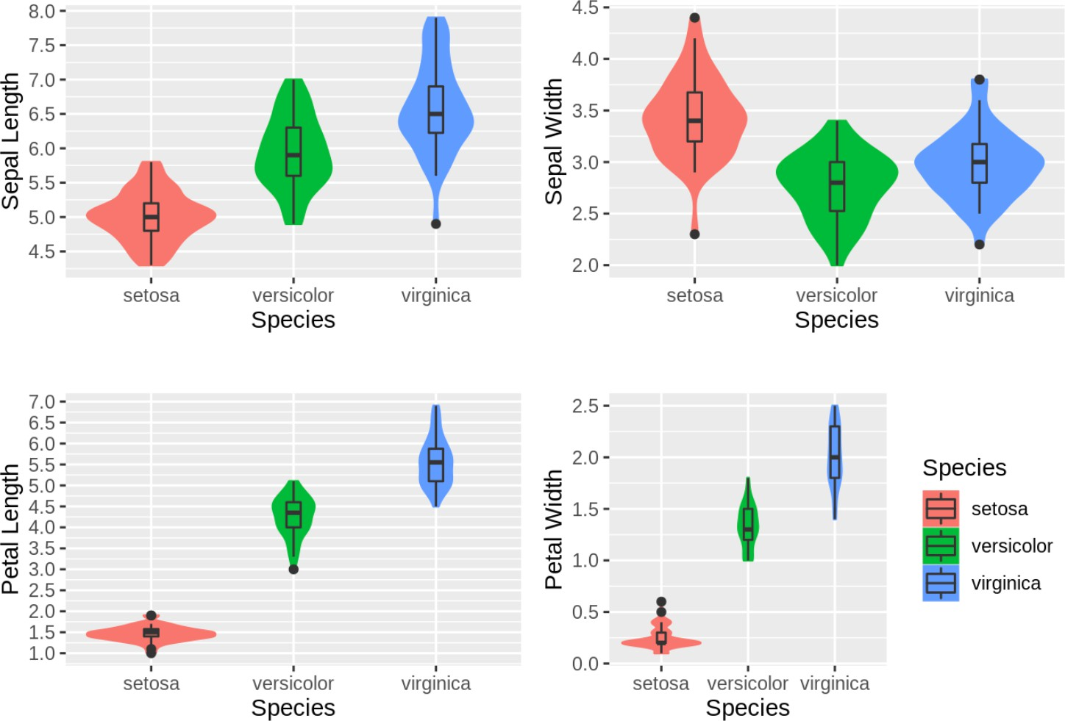
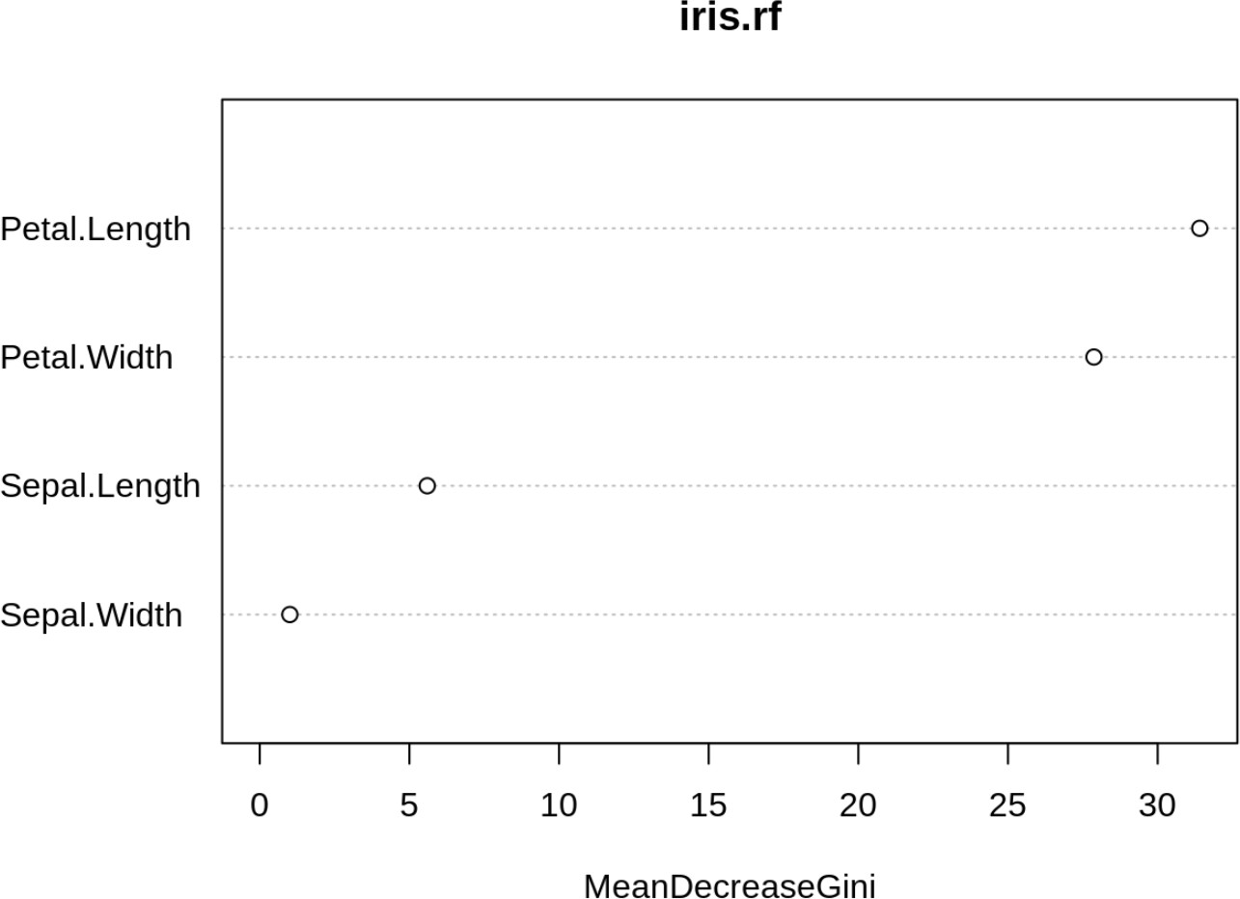
Random Forests: Variable Importance (PRACTICAL)

Slide 17
Practical
App to teach feature selection
https://sb2333.shinyapps.io/shiny_feature_selection/
Feature selection using linear models
https://github.com/neelsoumya/python_machine_learning/blob/main/feature_engineering_linearmodels.ipynb
Feature engineering using some business cases
https://github.com/neelsoumya/python_machine_learning/blob/main/business_cases_feature_engneering.ipynb
Advanced material
https://github.com/neelsoumya/python_machine_learning/blob/main/feature_selection.ipynb

Slide 18
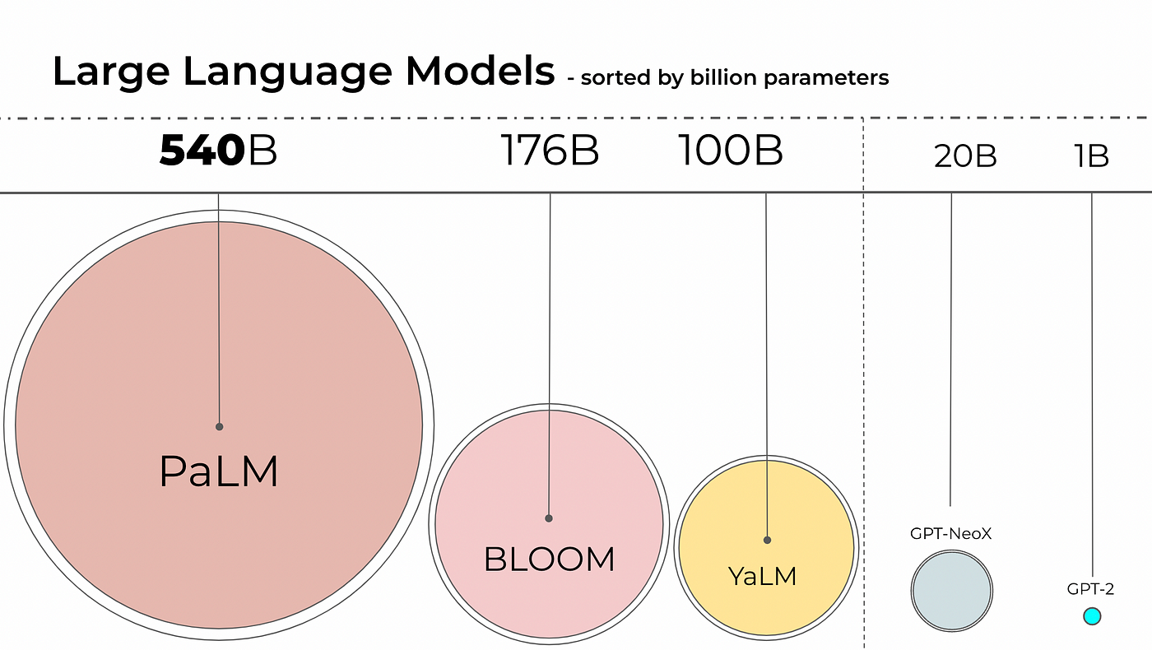
Applications of this concept
https://ashukumar27.medium.com/decoding-large-language-models-quantization-ff58964c0f31

Slide 19
Ethics
Black box models
Maybe more accurate but difficult to interpret
Decision trees and logistic regression may be more interpretable but less accurate
Ethics of black-box models (may hide bias, relevant in hiring, recidivism, etc.)
Case of lithium medication (not explainable but works)

Slide 20
Resources
Code, practicals and talk (recorded)
https://github.com/neelsoumya/public_supervised_machine_learning
https://github.com/neelsoumya/practical_supervised_machine_learning
Free PDF of book and R code
https://www.statlearning.com/resources-second-edition
More practical tutorials and R code
https://cambiotraining.github.io/intro-machine-learning/

